Slide 1
Psoriasis
Characteristics
Chronic, proliferative skin disorder - Characterized by:
  Defined erythematous patches
  Covered with distinctive silvery scales
Typical onset age: late 20s to early 30s
Affect both genders equally
Genetics ???? (as ~ 35% have family member)
  HLA-Cw6: 9-15x more prevalent
  HLA-B17 or B27 more severe disease
Pathogenesis
Unclear
Begins in the bottom (basal) layer of skin with the production of immature skin cells (keratinocytes) and epidermal stem cells
Normal cell growth: keratinocytes mature over a period of about one month
Psoriasis: keratinocytes mature over period of 1-4 days Epidermal plaque formation results

Slide 2
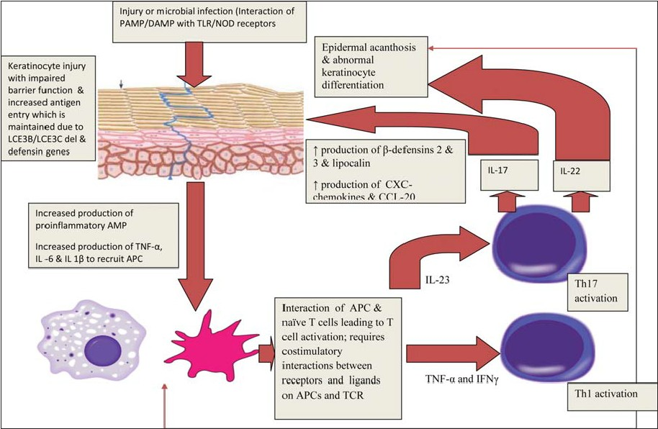
http://www.ijdvl.com/article.asp?issn=0378-6323;year=2013;volume=79;issue=7;spage=1;epage=9;aulast=Mahajan

Slide 3
Immune Component to Psoriasis
Cellular infiltrates include neutrophils in the dermis and epidermis; T cells in the dermis
Several growth factors including epidermal growth factor receptor appear to be activated in psoriatic skin
Cytokines including interleukins and interferons, & TNFα are over expressed
Variants of Psoriasis
Plaque
Guttate (lesions 1 cm in diameter)
Seborrheic
Pustular
Nail (seen in ~ 50% of all patients)
Psoriatic arthritis (affect 7-40% of patients with psoriasis)

Slide 4
Trigger to Psoriasis “Flares”
Weather: cold, dry weather
Photosensitive psoriasis
Stress: 40% of patients
Infection
Skin Injury: Koebner response
Drugs:
  Beta blockers, chloroquine, ACE-I, progesterone, lithium, drug rashes
Not curable
Suffering: emotional, social, & physical
Relapses and remission
NOT cancerous or contagious
Classifications
  Mild: < 3-5% of body surface
  Moderate: 5-20% of body surface
  Severe: > 20% of body surface

Slide 5
Treatment
Four approaches
  Topical (70-80% treated with topicals)
  Phototherapy
  Systemic oral drug therapy
  Biologicals

Slide 6
TOPICALS
Emollients … hydrate stratum corneum & enhance desquamation, minimize itching
Keratolytics … remove scale with Salicylic acid prep 2-10% … avoid application to large inflammed areas to avoid salicylism (N/V, tinnitus, hyperventilation)
Corticosteroids
(Low, medium, high potency)
  Hydrocortisone
  Fluocinolone
  Desonite
  Fluticazone
  Clocortolone
  Fluocinonide
  Betamethasone
  Mometasone
  Halobetasol
  Dilforasone
  Clobetasol
Coal Tar
Anthralin
Calcipotriene
Retinoids
  Tazarotene
Calcineurin Inhibitors
  Tacrolimus
  Pimecrolimus
Face … cream
Scalp – 0.05% alcohol sol
Thick plaques on extensor surface … ointment

Slide 7
SYSTEMIC
Methotrexate
Retinoids
  Acitretin replaces Etretinate
Immunosuppressants
  Cyclosporine
  Tacrolimus
  Mycophenolate
  Sulfasalazine
  Hydroxyurea
Biologicals
  Ustekinumab
  Alefacept
  Etanercept
  Infixinumab
  Adalimumab

Slide 8
Corticosteroids
Corticosteroids - MOA
  Reduce inflammation
  Inhibit cell proliferation
  Immunosuppressive
  Anti-pruritic
Side effects are based on potency
  Burning, local irritation, acne, thinning of skin, dilated blood vessels/bruising, hypopigmentation
Generally psoriasis becomes “steroid resistant” needing more potent corticosteroid preparations
Intermittent or pulse dosing to prevent tachyphylaxis
Generally limit to 3 week of continuous use

Slide 9
Coal Tar
Inhibits enzymes that contribute to psoriasis associated with cell proliferation
Can cause unwanted phototoxicity
2-10% preparations in creams, lotions, shampoos, and gels
Messy, strong odor, skin irritant
Anthralin (Drithocreme)
Inhibits DNA synthesis and cell proliferation
Recommended for chronic and not acute psoriasis or inflamed eruptions
Stains
Usually apply overnight with occlusion
Hair application: wash first with warm mineral oil to soften plaques

Slide 10
Calcipotriene
(Donovex)
Vitamin D3 analog
Regulates cell proliferation and suppresses lymphocytic activity
Safe and effective for long term and short term use
Generally BID application for 8-10 days
Taclonex: combination for calcipotriene and betamethasone
Also available is topical calcitriol (Vectical)
Retinoid
(Tazarotene)
Vitamin A derivatives
Used for mild to moderate psoriasis
Improvement in one week of treatment in 70% of patients
Adverse effects: localized irritation
Pregnancy Risk Category: X

Slide 11
Calcineurin Inhibitor
(Tacrolimus 0.1%, Pimecrolimus 1%)
Good for facial lesions and axillary psoriasis
  Skin atrophy is not seen with these products
Primary use for eczema but also used in psoriaris (not as efficacious as other topicals)
May be useful for sensitive areas affected such as the face
2005 FDA alert about possible link between topical tacrolimus and pimecrolimus and causes of lymphoma and skin cancers in children and adults (therefore recommended as a second line agent especially in children)

Slide 12
Systemic Treatment
Methotrexate (Rheumatrex)
Retinoid
Acitretin (Soriatane) replaces Etretinate (discontinued)
Immunosuppressant
Cyclosporine
Tacrolimus
Mycohenolate
Sulfasalazine
Hydroxyurea

Slide 13
Methotrexate
Dosing
Generally 25 mg po max/week
generally one day per week with folic acid supplement
Substantial improvement seen in 4 weeks in most patients
Try to dose reduce and return to topical treatments if possible
Toxicity
GI: nausea, vomiting and mucositis
Hepatotoxicity
Bone marrow: rare with psoriasis dosing

Slide 14
Methotrexate
Monitoring for Hepatoxicity
AST/ALT every 1-3 mos
NO risk factors
WITH risk factors
- AST normal
- Cum. dose: 3.5 – 4 g
- 5 of 9 AST ↑ over 12 mos
- Albumin ↓
- AST normal
- Cum. dose: 1 – 1.5 g
Liver Biopsy

Slide 15
Methotrexate
Drug Interactions
Decreased renal elimination
  Nephrotoxins
  Salicylates
  NSAIDs
  Probenecid
  Most beta-lactams
Displacement of methotrexate for protein binding sites
  Salicylates
  Phenytoin
  Warfarin
  Retinoids
  Bactrim
  Probenicid
  Barbiturates
Hepatotoxicity: concomitant liver toxins

Slide 16
Oral Retinoids
Etretinate (discontinued) due to storage in adipose tissue for up to 3 yrs
Acitretin (Soriatane) has replaced etretinate as primary oral retinoid
Metabolite of etretinate & eliminated in about 4 wks
Alcohol will convert acetretin to etretinate
Anti-inflammatory actions
Regulates cell reproduction
For more severe recalcitrant (not responsive to Tx) disease
Toxicity
Hypervitaminosis A syndrome
  Skin thinning
  Thin, soft nails
  Reversible hair loss
  Rash
  Extraspinal tendon and ligament calcifications
  Hyperlipidemics
  Hepatotixity
WARNING: Category X
Mutagenic
Teratogenic

Slide 17
Other Systemic Therapies
Immunosuppressant properties with:
  Cyclosporine
  Tacrolimus
  Mycophenolate
  Sulfasalazine
  Hydroxyurea

Slide 18
Systemic/ Phototherapy
PUVA : Psoralen and ultraviolet A therapy
For severe incapacitating unresponsive psoriasis
Mechanism of Action:
Psoralens reacts with nucleic acids and intercalates between base pairs
With UVA light (320-400 nm) DNA becomes irradiated and leads to covalent bonding of psoralens to DNA pyrimidine bases
A psoralen medicine is taken 1½ to 2 hours before you are exposed to UVA light
Tx takes 8 hrs and the treatment is repeated 2 to 3 times a week
The dose of medicine is not increased, but the amount of light may be increased.

Slide 19
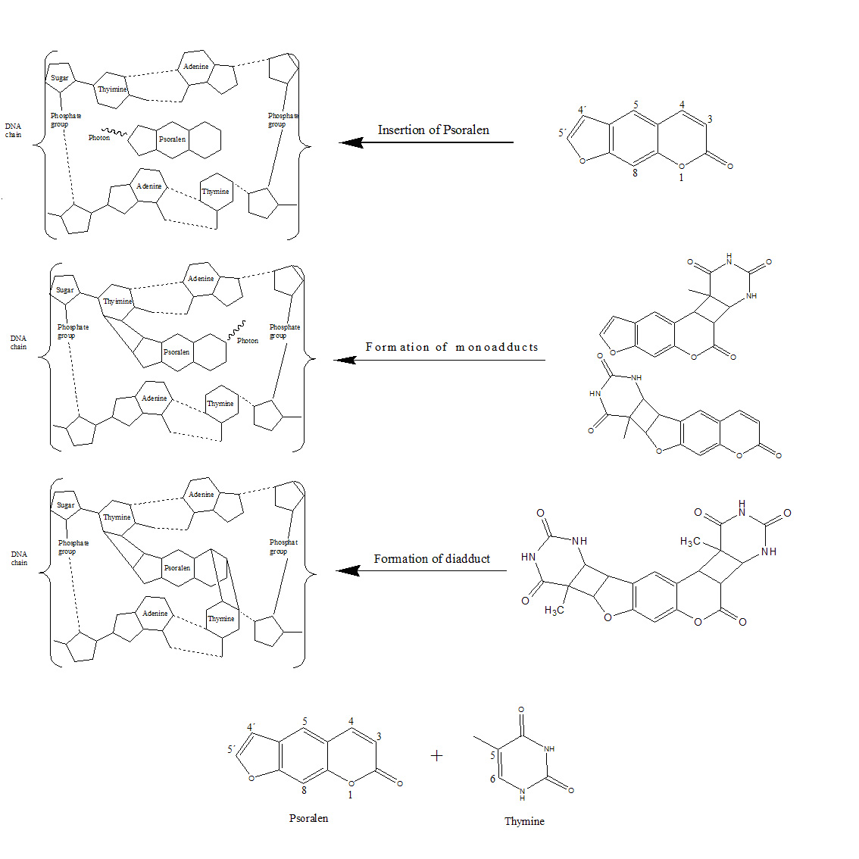

Slide 20
BIOLOGICAL AGENTS FOR PSORIASIS

Slide 21
  Ustekinumab (Stelara)
    Targets interleukins (12, 23)
  Alefacept (Amevive)
    Inhibit T cell activation
  Etanercept (Enbrel)
  Infliximab (Remicade)
  Adalimumab (Humira)

Slide 22
Ustekinumab
http://www.ijdvl.com/article.asp?issn=0378-6323;year=2013;volume=79;issue=7;spage=1;epage=9;aulast=Mahajan

Slide 23
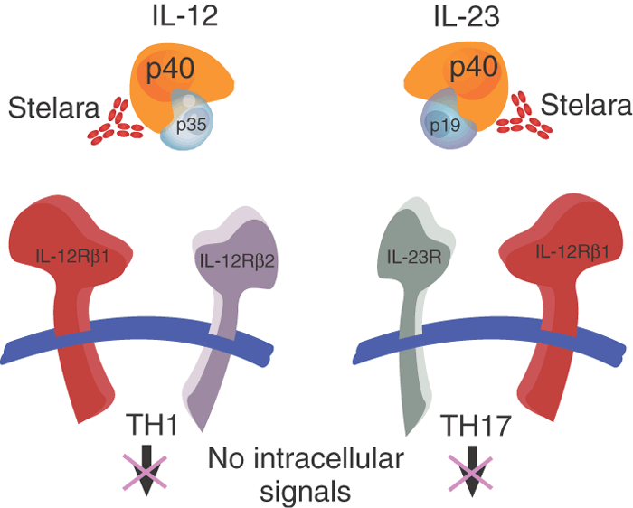
Ustekinumab blocks two proteins called IL-12 and IL-23 that are shown to be present in psoriatic plaques. This may slow down how fast skin cells are made and may reduce inflammation.
TH1 & TH17 are T-helper cells
http://users.rcn.com/jkimball.ma.ultranet/BiologyPages/T/Th1_Th2.html

Slide 24
Alefacept inhibits the activation of CD4⁺ and CD8⁺ T cells by interfering with CD2 on the T cell membrane thereby blocking the costimulatory molecule LFA-3/CD2 interaction
Another mechanism is inducing apoptosis of memory-effector T lymphocytes. If the T cells were to become activated they would stimulate proliferation of keratinocytes resulting in the typical psoriatic symptoms
http://people.eku.edu/ritchisong/301notes4b.html

Slide 25
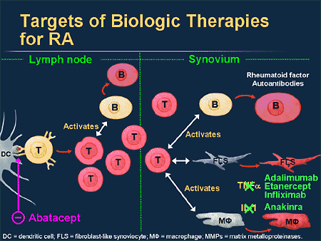

Slide 26
Newest Biologicals
MOA & Dosing
Ustekinumab: Stelara
Blockade of these cytokines slows the hyperkeratinization of skin cells
Dosing
  < 100 kg: 45 mg subq; repeat in 4 weeks, then every 12 weeks
  > 100 kg: 90 mg subq; repeat in 4 weeks, then every 12 weeks
Efficacy
Ustekinumab: 12 weeks of treatment
  Treatment improvement achieved in 75% of patients compared to 3% in placebo group
  Time to relapse: up to 76 weeks
Alefacept: 12 weeks of therapy
  ~ 28-33% of patients had a 75 % improvement of symptoms compared to 5% of placebo
  Time to relapse: 30 wks
Adverse Effects
Infusion related reactions
Serious infections: acute and reactivation of chronic infections
Risk of secondary malignancies: lymphomas
Myelosuppression
Long term effects still not known

